Slide 1


J Chat
160117733157
160117733165

Slide 2

Problem Definition
Develop an android real-time messaging or chatting application with an aim to facilitate chatting with different classes and option to connect to nearby people and chat with them.

Slide 3
Abstract
Unlike the conventional chat apps, J Chat app provides a user to customize their chats based on the categories like Personal, Close Friends, Business and Others and be able to modify their preferences easily.
The project is developed in two phases, in the first phase a simple one to one chat functionality is planned to be developed and in the later phase, we also aim to provide the functionality to identify and connect to nearby users on a request.
Additionally, it is also planned to include a group chat mechanism along with a provision to share other forms of data apart from text messages.

Slide 4
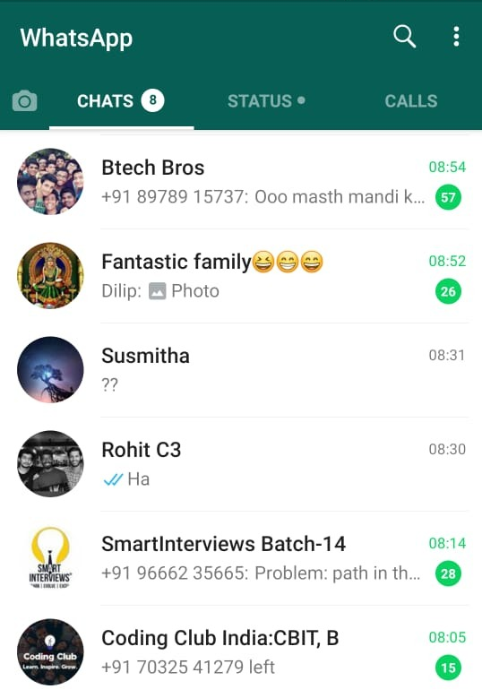
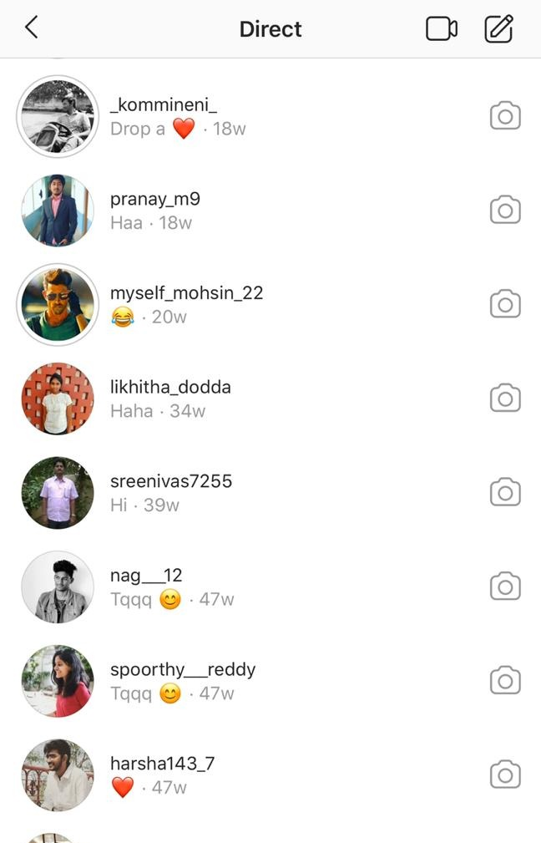
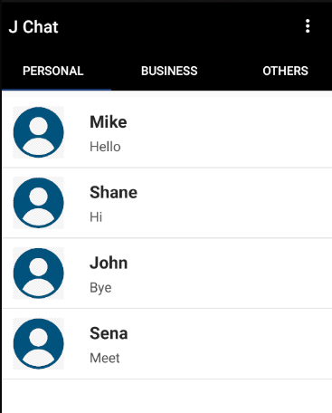
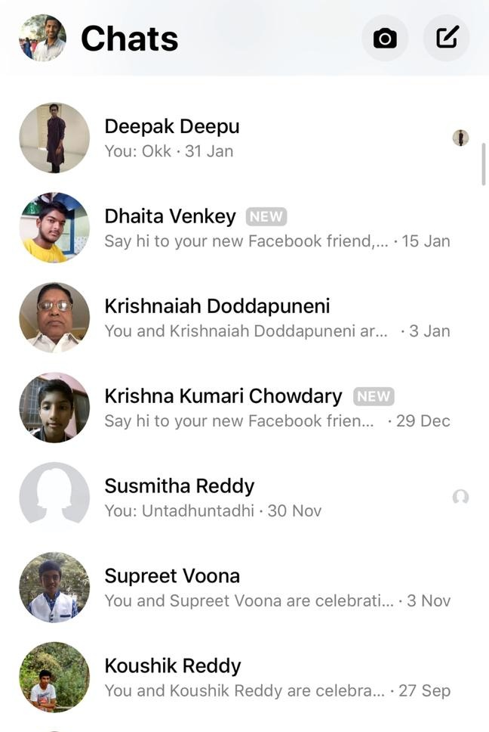
Current System and Proposed Solution
J Chat
Whatsapp
Instagram
Facebook Messenger

Slide 5


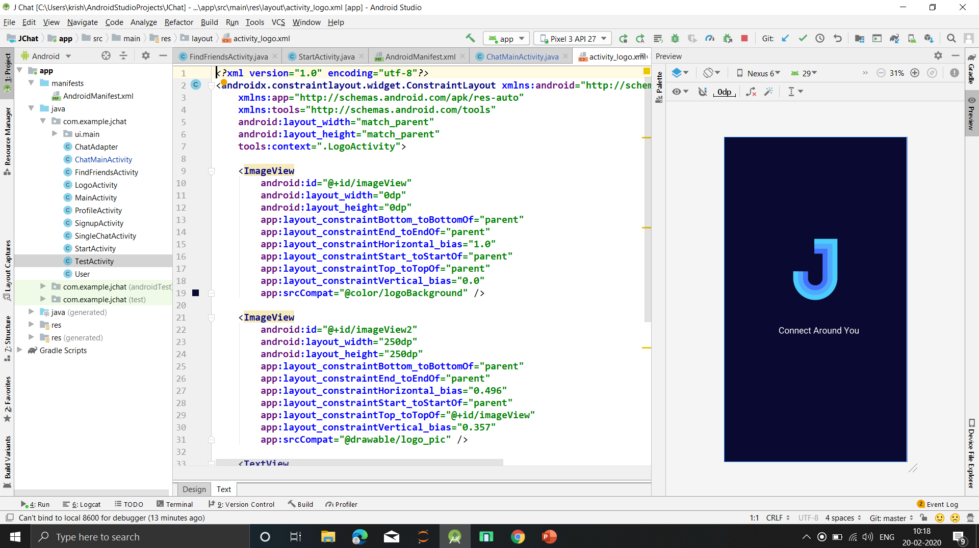
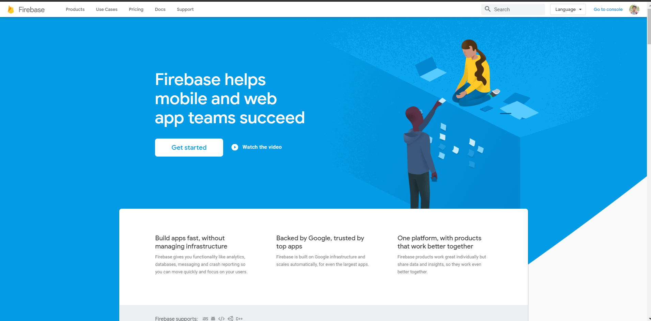
Technologies Used

Slide 6
Features
User Authentication
Chat
Prioritize Chats
Group Chatting
Add Friend with Email

Slide 7
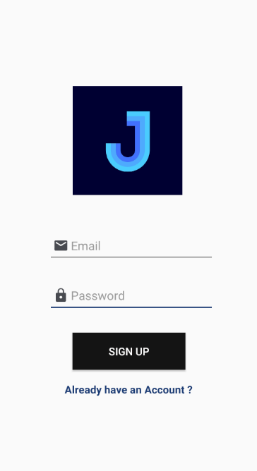
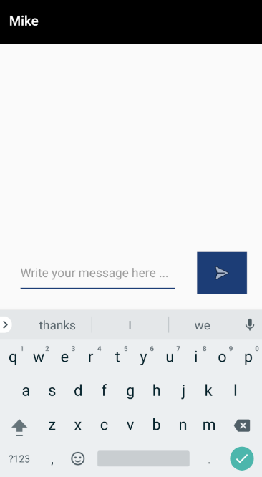

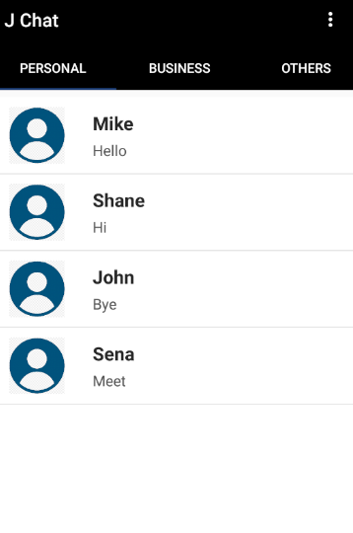
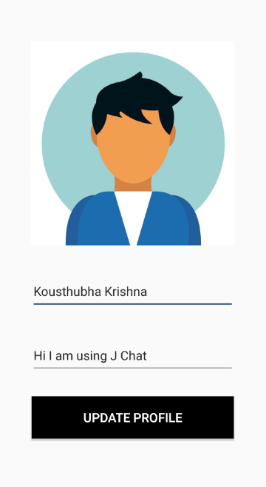
Screen Shots
Sign Up
Chat Screen
Chat Classes
Profile

Slide 8
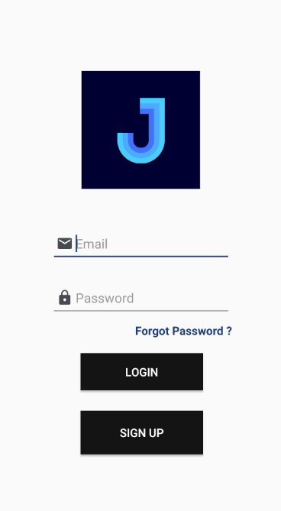

Screen Shots
Login
Add Friend

Slide 9
Future Implementation
Location based
connection
Group Chats
Image and File Sharing
Enhanced UI
Lock Chats

Slide 10
Thank You …

